Slide 1


Electric Circuits
Twelfth Edition, Global Edition
Chapter 9 – Part 1
Sinusoidal Steady-State Analysis
© 2024 Pearson Education Ltd. All Rights Reserved
Notes:
If this PowerPoint presentation contains mathematical equations, you may need to check that your computer has the following installed:
1) Math Type Plugin
2) Math Player (free versions available)
3) NVDA Reader (free versions available)

Slide 2
Chapter 9 – Sinusoidal Steady-State Analysis (1 of 24)
Objectives:
9.1 Be able to perform a phasor transform and its inverse;
9.2 Be able to phasor-transform a circuit;
9.3 Solve arbitrarily complex circuits with sinusoidal sources using phasor method.

Slide 3
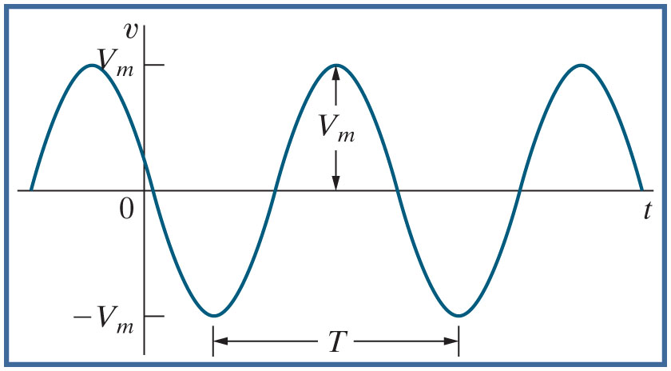






Chapter 9 – Sinusoidal Steady-State Analysis (2 of 24)
Review the terminology of sinusoids
Amplitude or magnitude
phase angle [deg]
angular frequency [rad/s]
frequency [Hz]
t : time [s]
period [s]

Slide 4




Chapter 9 – Sinusoidal Steady-State Analysis (3 of 24)
What is the frequency of the sinusoid given below?
A.
B.
C.

Slide 5


Chapter 9 – Sinusoidal Steady-State Analysis (3 of 24)
What is the frequency of the sinusoid given below?
A.
B.
C.

Slide 6

Chapter 9 – Sinusoidal Steady-State Analysis (4 of 24)
What is the phase angle of the sinusoid given below?
A. −60 deg
B. −60 rad
C. 60 deg

Slide 7
Chapter 9 – Sinusoidal Steady-State Analysis (4 of 24)
What is the phase angle of the sinusoid given below?
A. −60 deg
B. −60 rad
C. 60 deg

Slide 8

Chapter 9 – Sinusoidal Steady-State Analysis (5 of 24)
Suppose we want to find the value of the sinusoidal current described below at t = 5 m s. When we substitute this value for t into the sinusoid, the argument for the cosine function has what units?
A. degrees
B. degrees
C. A mix of degrees and radians

Slide 9
Chapter 9 – Sinusoidal Steady-State Analysis (5 of 24)
Suppose we want to find the value of the sinusoidal current described below at t = 5 m s. When we substitute this value for t into the sinusoid, the argument for the cosine function has what units?
A. degrees
B. degrees
C. A mix of degrees and radians

Slide 10




Chapter 9 – Sinusoidal Steady-State Analysis (6 of 24)
Evaluating a sinusoid at a specified time
has the units rad/s
has the units radians
45 has the units degrees
Need to convert
to degrees, or 45 to radians, and set
your calculator appropriately! At (t = 1s )
Thus,

Slide 11

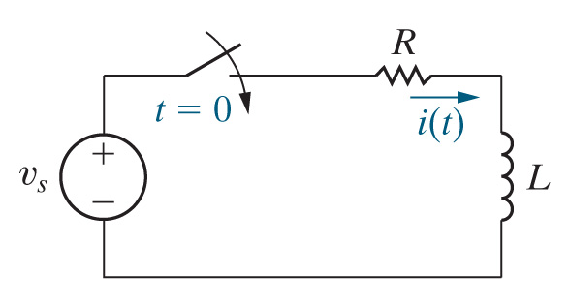
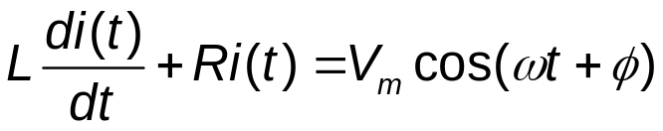
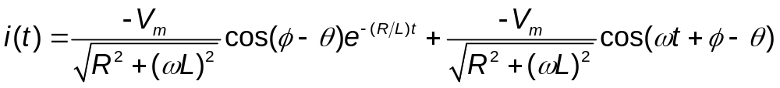

Chapter 9 – Sinusoidal Steady-State Analysis (7 of 24)
Suppose
in the circuit below:
The equation for i(t) is
The solution of this equation for i(t) is
where
Notes:
Long Description:
i (t) equals Start Fraction negative V subscript m baseline over StartRoot R squared plus (omega L) squared EndRoot End Fraction cosine Open Parenthesis phi minus theta Close Parenthesis e to the negative Open Parenthesis R divided by L Close Parenthesis t power plus Start Fraction negative V subscript m baseline over StartRoot R squared plus (omega L) squared EndRoot End Fraction cosine Open Parenthesis omega t plus phi minus theta Close Parenthesis.

Slide 12

Chapter 9 – Sinusoidal Steady-State Analysis (8 of 24)
Consider the equation for the current in the R L circuit with the sinusoidal source:
Which term(s) go to 0 as
A. The first term
B. The second term
C. Both terms
D. Neither term
Notes:
Long Description:
i (t) equals Start Fraction negative V subscript m baseline over StartRoot R squared plus (omega L) squared EndRoot End Fraction cosine Open Parenthesis phi minus theta Close Parenthesis e to the negative Open Parenthesis R divided by L Close Parenthesis t power plus Start Fraction negative V subscript m baseline over StartRoot R squared plus (omega L) squared EndRoot End Fraction cosine Open Parenthesis omega t plus phi minus theta Close Parenthesis.

Slide 13
Chapter 9 – Sinusoidal Steady-State Analysis (8 of 24)
Consider the equation for the current in the R L circuit with the sinusoidal source:
Which term(s) go to 0 as
A. The first term
B. The second term
C. Both terms
D. Neither term
Notes:
Long Description:
i (t) equals Start Fraction negative V subscript m baseline over StartRoot R squared plus (omega L) squared EndRoot End Fraction cosine Open Parenthesis phi minus theta Close Parenthesis e to the negative Open Parenthesis R divided by L Close Parenthesis t power plus Start Fraction negative V subscript m baseline over StartRoot R squared plus (omega L) squared EndRoot End Fraction cosine Open Parenthesis omega t plus phi minus theta Close Parenthesis.

Slide 14
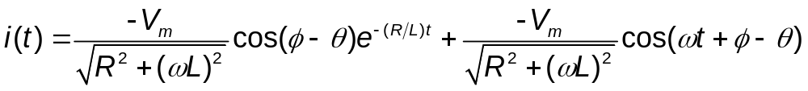
Chapter 9 – Sinusoidal Steady-State Analysis (9 of 24)
The first term is the transient term – it decays to 0 as t goes to infinity
The second term is the steady-state term – it persists for all time greater than 0. This term
  Is sinusoidal
  Has the same frequency as the input voltage
  Has a different magnitude and phase angle compared to the input voltage
Notes:
Long Description:
i (t) equals Start Fraction negative V subscript m baseline over StartRoot R squared plus (omega L) squared EndRoot End Fraction cosine Open Parenthesis phi minus theta Close Parenthesis e to the negative Open Parenthesis R divided by L Close Parenthesis t power plus Start Fraction negative V subscript m baseline over StartRoot R squared plus (omega L) squared EndRoot End Fraction cosine Open Parenthesis omega t plus phi minus theta Close Parenthesis.

Slide 15
Chapter 9 – Sinusoidal Steady-State Analysis (10 of 24)
The circuit analysis techniques we are studying will allow us to calculate the sinusoidal steady-state response of the circuit – that is, the circuit’s response to a sinusoidal input once the transient response has effectively decayed to 0.
This is also called the A C Steady-State (A C S S) response.

Slide 16






Chapter 9 – Sinusoidal Steady-State Analysis (11 of 24)
Phasor
  A complex number in polar form, with a magnitude and phase angle
  Derived from a sinusoid using the phasor transform
Euler’s identity:
Now

Slide 17
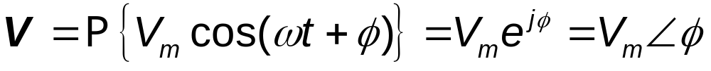
Chapter 9 – Sinusoidal Steady-State Analysis (12 of 24)
Phasor transform
  Extracts a sinusoid’s magnitude and phase angle
  Transforms a function of time into a function of frequency
Inverse phasor transform
  Turns a phasor back into a sinusoid, if someone tells you the frequency
Notes:
Long Description 1:
V equals P Open Curly Bracket V subscript m baseline cosine Open Parenthesis omega t plus phi Close Parenthesis Close Curly Bracket equals V subscript m baseline e to the j phi power equals V subscript m baseline angle phi.
Long Description 2:
v (t) equals P inverse Open Curly Bracket uppercase V Close Curly Bracket equals P inverse Open Curly Bracket uppercase V subscript m baseline angle phi Close Curly Bracket equals uppercase V subscript m baseline cosine Open Parenthesis omega t plus phi Close Parenthesis.

Slide 18



Chapter 9 – Sinusoidal Steady-State Analysis (13 of 24)
Suppose
Then the phasor transform of i(t) is
A. 36 mA
B.
C.

Slide 19
Chapter 9 – Sinusoidal Steady-State Analysis (13 of 24)
Suppose
Then the phasor transform of i(t) is
A. 36 mA
B.
C.

Slide 20
Chapter 9 – Sinusoidal Steady-State Analysis (14 of 24)
Adding or subtracting sinusoids in the time domain is hard (you need trig identities!) But if you phasor-transform the sinusoids, it is easy to combine them. For example,

Slide 21
Chapter 9 – Sinusoidal Steady-State Analysis (15 of 24)
Consider the equations that relate voltage and current in a resistor, inductor, and capacitor in the time domain, and in the phasor domain.

Slide 22
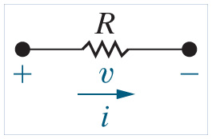
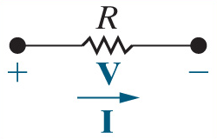





Chapter 9 – Sinusoidal Steady-State Analysis (16 of 24)
Resistors:
Phasor (frequency) domain
Time domain
Note that the voltage and current phasors for a resistor have the same phase angle – therefore we say that the voltage and current in a resistor are “in phase”.

Slide 23
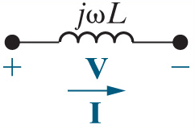










Chapter 9 – Sinusoidal Steady-State Analysis (17 of 24)
Inductors:
Phasor (frequency) domain
Time domain
In an inductor, the voltage leads the current by

Slide 24
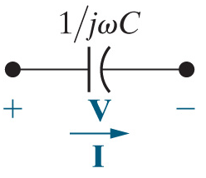
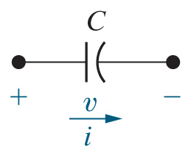









Chapter 9 – Sinusoidal Steady-State Analysis (18 of 24)
Capacitors:
Phasor (frequency) domain
Time domain
In a capacitor, the voltage lags the current by

Slide 25
Chapter 9 – Sinusoidal Steady-State Analysis (19 of 24)
The impedance of a resistor is
A. Always a real number
B. Always an imaginary number
C. A complex number with real and imaginary parts

Slide 26
Chapter 9 – Sinusoidal Steady-State Analysis (19 of 24)
The impedance of a resistor is
A. Always a real number
B. Always an imaginary number
C. A complex number with real and imaginary parts

Slide 27
Chapter 9 – Sinusoidal Steady-State Analysis (20 of 24)
The impedance of an inductor is
A. A real number
B. A positive imaginary number
C. A negative imaginary number

Slide 28
Chapter 9 – Sinusoidal Steady-State Analysis (20 of 24)
The impedance of an inductor is
A. A real number
B. A positive imaginary number
C. A negative imaginary number

Slide 29

Chapter 9 – Sinusoidal Steady-State Analysis (21 of 24)
The impedance of a capacitor has the units
A. Farads [F]
B. Henries [H]
C. Ohms

Slide 30
Chapter 9 – Sinusoidal Steady-State Analysis (21 of 24)
The impedance of a capacitor has the units
A. Farads [F]
B. Henries [H]
C. Ohms

Slide 31
Chapter 9 – Sinusoidal Steady-State Analysis (22 of 24)
Impedance is a phasor.
A. True
B. False

Slide 32
Chapter 9 – Sinusoidal Steady-State Analysis (22 of 24)
Impedance is a phasor.
A. True
B. False

Slide 33







Chapter 9 – Sinusoidal Steady-State Analysis (23 of 24)
Summary:
In the time domain
  Resistor:
  inductor:
  Capacitor:
In the phasor domain
  Z is impedance, defined as the ratio of V to I
  Z has the units Ohms
  Resistor:
  Inductor:
  Capacitor:

Slide 34






Chapter 9 – Sinusoidal Steady-State Analysis (24 of 24)
Summary:
In the time domain
  Ohm’s law (only for resistors):
  K V L (around a loop):
  K C L (at a node):
  These three laws lead to all other time-domain circuit analysis techniques
In the phasor domain
  Ohm’s law (for R, L, C):
  K V L (around a loop):
  K C L (at a node):
  These three laws mean we can use all time-domain circuit analysis techniques in the phasor domain!

Slide 35

Copyright
This work is protected by United Kingdom copyright laws and is provided solely for the use of instructors in teaching their courses and assessing student learning. Dissemination or sale of any part of this work (including on the World Wide Web) will destroy the integrity of the work and is not permitted. The work and materials from it should never be made available to students except by instructors using the accompanying text in their classes. All recipients of this work are expected to abide by these restrictions and to honor the intended pedagogical purposes and the needs of other instructors who rely on these materials.

